Slide 1


End-to-End IIoT Data Pipeline: Edge → Database → Visualization (LAB- 12)
Data Collection Strategies for AI-Powered Additive Manufacturing
To build a real-time IoT data flow using Raspberry Pi and Sense HAT sensors.
Presented by: Jeet Khut,Nisarg Nakrani, Nisarg Patel
Date: 11-08-2025

Slide 2
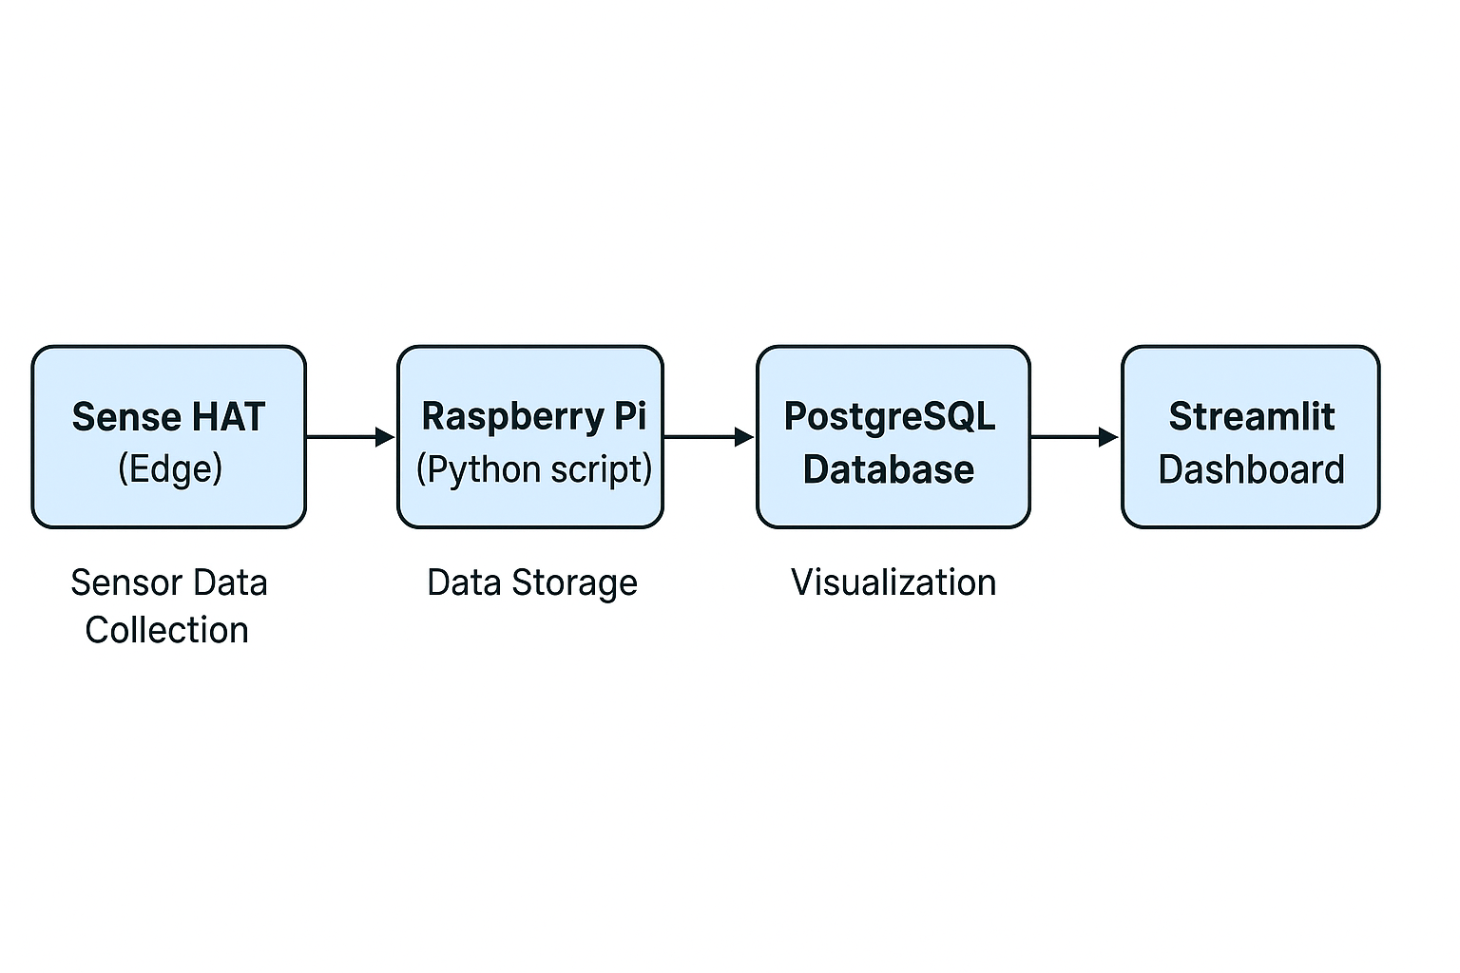
System Architecture
Overview
This project demonstrates the full Industrial Internet of Things (IIoT) data flow from sensor data collection at the edge to real-time visualization.
How It Works
Sense HAT collects temperature, humidity, pressure, and orientation data.
Raspberry Pi reads sensor values and sends them to the database using SQL commands.
PostgreSQL stores data in a structured table with timestamps.
Streamlit Dashboard retrieves and visualizes the data dynamically as live plots.
Architecture Flow

Slide 3
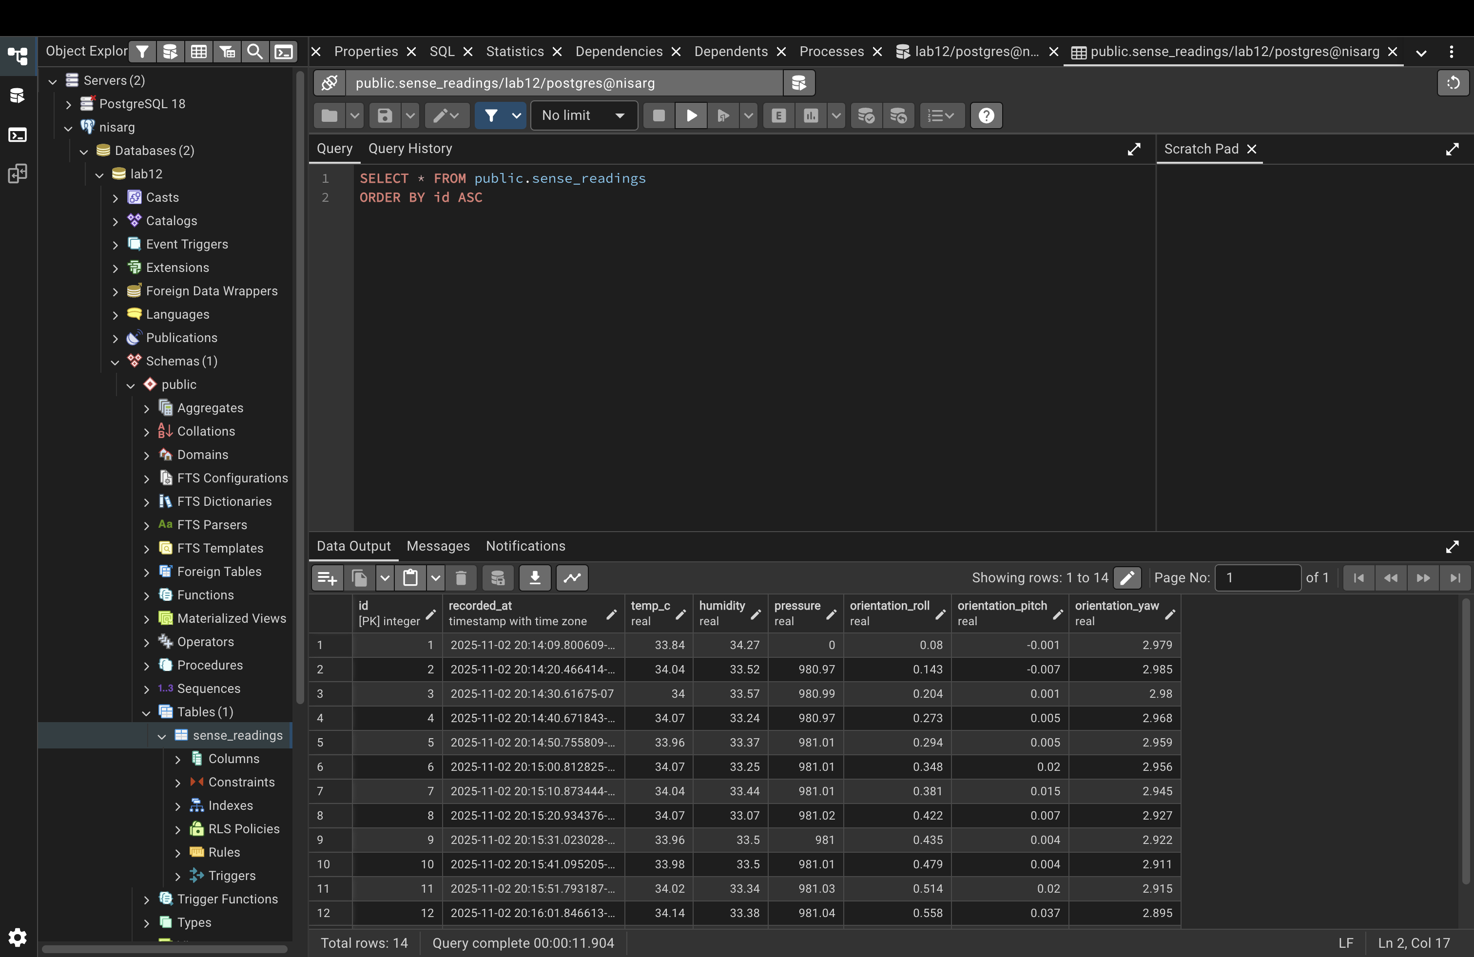
Data Storage in postgreSQL
Overview
Sensor readings collected from the Sense HAT on the Raspberry Pi are automatically stored in a PostgreSQL database using a Python script.
Each record includes temperature, humidity, pressure, and orientation data with a timestamp.
Key Points
Data is saved in real time using simple SQL commands.
PostgreSQL keeps the data organized and easy to access.
The stored data is later used in Streamlit for live charts and graphs.

Slide 4
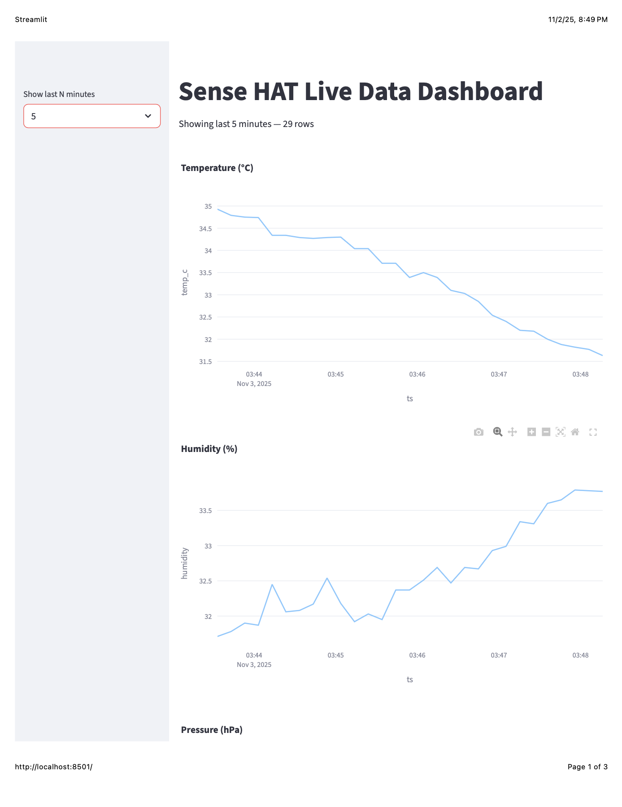
Streamlit Visualization Dashboard
Overview
The Streamlit dashboard retrieves sensor readings from the PostgreSQL database and displays them as real-time graphs.
Users can adjust the time window and view live changes in environmental data.
Key Points
Shows live plots of temperature, humidity, pressure, and orientation.
Updates automatically as new data is added to the database.
Built using Python, Streamlit, and Plotly for smooth visualization.

Slide 5
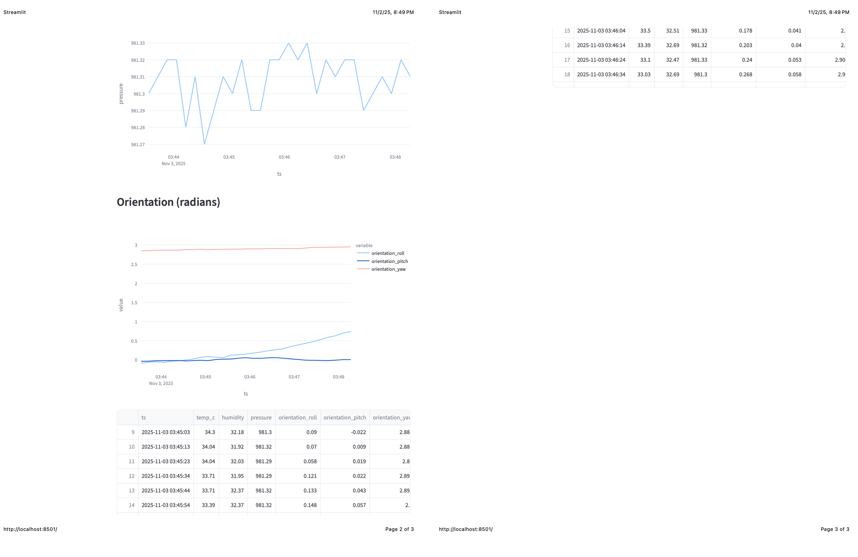

Slide 6


